Slide 1


HTML 5
New APIs - Part 1

Slide 2

HTML5 - New APIs
Course objectives
By completing this course, you will be able to:
Develop multi-threaded JS applications
Use Drag & Drop features in your web apps
Geolocalize a user of your web apps

Slide 3


HTML5 - New APIs
Course topics
Course’s plan:
Web Workers
Drag & Drop
Geolocation

Slide 4

Web worker
HTML5 - New APIs

Slide 5

Web Worker
Presentation
Web Workers API allows you to run scripts in the background
Independently of any user interface scripts !
Useful for long-running scripts
Don’t need to manage yielding to keep the page responsive

Slide 6
Web Worker
Thread safety
Web Workers use real OS-level threads
As in other technologies, bad concurrency code can cause starvations, dead locks and other side effects

Slide 7
Web Worker
Thread safety
To limit these issues, the API provides :
A carefully controlled communication between threads
No access to non-thread safe components or the DOM

Slide 8
Web Worker
Worker interface
The core of the API is the Worker interface
It provides the following constructor :
Worker(scriptUrl) :
Creates a web worker that executes the script at the specified URL

Slide 9
Web Worker
Worker interface
It also provides the following methods :
postMessage(message) :
Sends a message to the worker's inner scope
terminate() :
Immediately terminates the worker without offers the worker an opportunity to finish its operations

Slide 10
Web Worker
Worker interface
And the following properties :
onmessage :
An event listener called when the worker return a message
onerror :
An event listener called when the worker return an error

Slide 11
Web Worker
Worker scope
Scripts executed by Workers have access to :
postMessage(message) function
Returns a message to the message handler of the main thread
onmessage property
Function which will receive messages sent when the worker object's postMessage() is called

Slide 12
Web Worker
Worker principle
Main thread
var worker = new Worker("worker.js");
worker.postMessage(message);
// Do something
worker.onmessage = function(event) {
// Do something
};
worker.js
...
onmessage = function(event) {
// Do something else
postMessage(message);
}

Slide 13
<ul id="result"></ul>
<script type="text/javascript">
var worker = new Worker('factorial.js');
worker.onmessage = function(event) {
var result = event.data;
var li = "<li>Factorial(" + result.n + "): ";
li += result.factorial + "</li>";
document.getElementById("result").innerHTML = li;
};
worker.postMessage(prompt("Number: "));
</script>
Example - index.html

Slide 14
function factorial(n, callback) {
if ((n == 0) || (n == 1)) callback(1);
else {
factorial(n - 1, function(result) {
postMessage({ n: (n - 1), factorial: result });
result *= n;
setTimeout(function() { callback(result) }, 2000);
});
}
}
self.onmessage = function(event) {
factorial(event.data, function(result) {
postMessage({ n: event.data, factorial: result });
});
}
Example - factoral.js

Slide 15
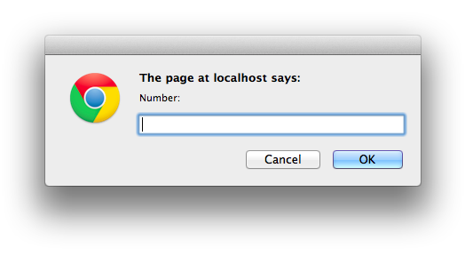
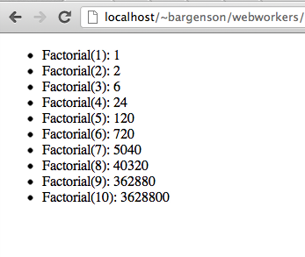
Web Worker
Example

Slide 16


Questions ?

Slide 17
Web Worker
Exercise (1/4)
During this exercise, we will develop a simple page which will
Fetch tweets about SUPINFO every 10 seconds
Display them

Slide 18
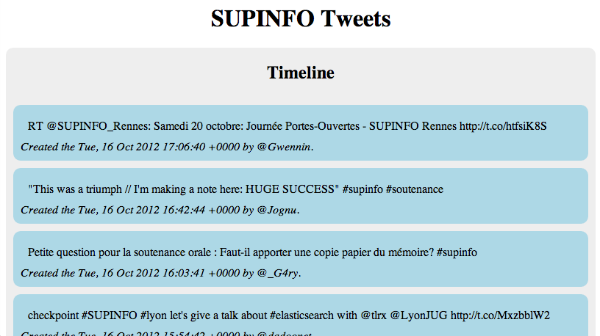
Web Worker
Exercise (2/4)

Slide 19
Web Worker
Exercise (3/4)
The script fetching the tweets must be execute by a WebWorker
You can retrieve the tweets about SUPINFO thanks to this URI :
http://search.twitter.com/search.json?q=SUPINFO&since_id=<LAST_TWEET_ID>
Notes:
LAST_TWEET_ID: must be the ID of the last tweet your received

Slide 20
Web Worker
Exercise (4/4)
Your script must check every 10 seconds if new tweets are available
If there are, you must send them to the UI thread to display them

Slide 21
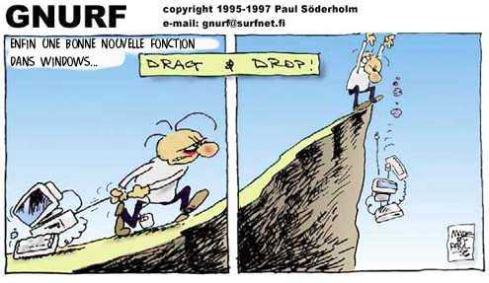
Drag & drop
HTML5 - New APIs

Slide 22
Drag & Drop
Presentation
Drag and drop is a very common feature
"grab" an object and drag it to a different location
In HTML5, drag and drop is part of the standard, and any element can be draggable

Slide 23
Drag & Drop
Draggable
To make an element draggable is very simple :
Give the element a draggable attribute
Set an event listener for dragstart event
<p>What fruits do you like?</p>
<ol>
<li draggable="true"> Apples </li>
<li draggable="true"> Oranges </li>
<li draggable="true"> Pears </li>
</ol>

Slide 24
Drag & Drop
Draggable
Handler :
var fruits = document.querySelectorAll("li[draggable]");
var fruit = null;
for (var i = 0; i < fruits.length; i++) {
fruit = fruits[i];
fruit.addEventListener("dragstart", function(event) {
console.log("dragstart");
});
};

Slide 25
Drag & Drop
Dropzone
To make an element accept a drop :
Give the element a dropzone attribute
Set an event listener for dragover event and cancel the event
Otherwise, no drop event will be triggered
Set an event listener for drop event

Slide 26
Drag & Drop
Dropzone
Example :
<ol dropzone="move string:text/x-example" ondragover="event.preventDefault()" ondrop="dropHandler(event)">
</ol>

Slide 27
Drag & Drop
Dropzone
The dropzone attribute specifies
What kind of data to accept
string:text/plain
file:image/png
...
What kind of feedback to give
move
copy
…

Slide 28
Drag & Drop
Dropzone
Instead of using the dropzone attribute, you can use :
A dragenter event handler
To report whether or not the drop target is to accept the drop
A dragover event handler
To specify what feedback is to be shown to the user

Slide 29
Drag & Drop
Dropzone
Example:
var zone = document.querySelector("ol[dropzone]");
zone.addEventListener("dragover", function(event) { ... });
zone.addEventListener("dragenter", function(event) { ... });
zone.addEventListener("dragleave", function(event) { ... });
zone.addEventListener("drop", function(event) { ... });

Slide 30
Drag & Drop
Data Transfer
DataTransfer object is used to transfer information from the draggable element to the dropzone
Accessible from the event parameter inside your handlers
fruit.addEventListener("dragstart", function(event) {
var dataTransfer = event.dataTransfer;
});

Slide 31
Drag & Drop
Data Transfer
The two main methods of the DataTransfer interface are :
getData(type)
Retrieves the data for a given type, or an empty string if does not exist
setData(type, data)
Sets the data for a given type

Slide 32
Drag & Drop
Data Transfer - Example
...
fruit.addEventListener("dragstart", function(event) {
event.dataTransfer.setData("text", this.id);
});
...
zone.addEventListener("dragover", function(event) {
event.preventDefault(); // allows us to drop
});
zone.addEventListener("drop", function(event) {
var fruitId = event.dataTransfer.getData("text");
// Append the fruit to the dropzone
});

Slide 33
Questions ?

Slide 34
Drag & Drop
Exercise (1/2)
Update your SUPINFO Tweets page :
Add a new area for your favorite tweets
Make it a drop zone
Make the timeline tweets draggable

Slide 35
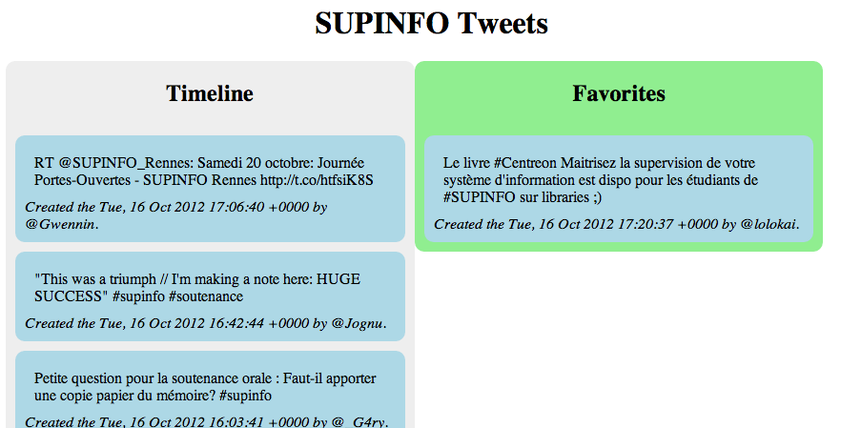
Drag & Drop
Exercise (2/2)

Slide 36

geolocation
HTML5 - New APIs

Slide 37
Geolocation
Presentation
The new Geolocation API defines a high-level interface to location information
The API itself is agnostic of the underlying location information sources
Can be GPS, location inferred from network signals as well as user input

Slide 38
Geolocation
Presentation
The API is designed to enable
"one-shot" position requests
repeated position updates
Location information is represented by latitude and longitude coordinates

Slide 39
Geolocation
One-shot position request
The Geolocation interface expose the following method to do that:
getCurrentPosition(callback)
The callback function take the user position as argument

Slide 40
Geolocation
One-shot position request
Example :
navigator.geolocation.getCurrentPosition( function(position){
console.log("Latitude: " + position.coords.latitude);
console.log("Longitude: " + position.coords.longitude);
});

Slide 41
Geolocation
Repeated position updates
The Geolocation interface expose also the following methods :
watchPosition(callback, errorHandler)
Request repeated updates and return a watcher ID
clearWatch(watchId)
Cancel the updates for a given watcher ID

Slide 42
Geolocation
Repeated position updates
Example :
var geolocation = navigator.geolocation
, watchId = geolocation.watchPosition(updateLocation, handleError);
function updateLocation(position) { // Do something }
function handleError(error) { // Display an error message }
document.getElementById("cancelButton").onclick = function() {
navigator.geolocation.clearWatch(watchId);
}

Slide 43
Questions ?

Slide 44
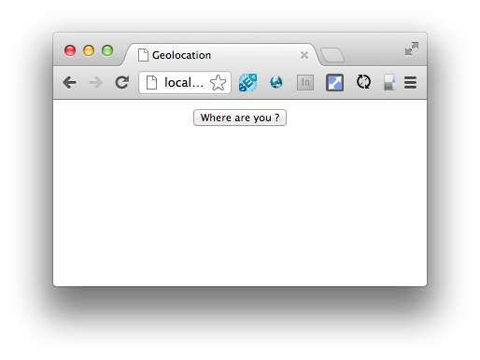
Geolocation
Exercise (1/3)
Create a new page with a simple button as follow :

Slide 45
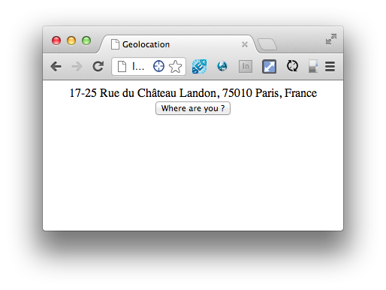
Geolocation
Exercise (2/3)
When the user clicks on the button, you have to display his address :

Slide 46
Geolocation
Exercise (3/3)
To convert coordinates to address, you can use the Google Maps Geocoder API:
https://developers.google.com/maps/documentation/javascript/geocoding

Slide 47


